Slide 1

FINANCIAL MATH
vs
FINFLUENCER MYTH
Using Algebra-Based Financial Applications as Reality Checks
Dr. Rich Sgroi
financialalgebra.com
dr.rsgroi@gmail.com
WHILE YOU ARE WAITING, PLEASE TRY THE DO NOW IN YOUR HANDOUT

Slide 2
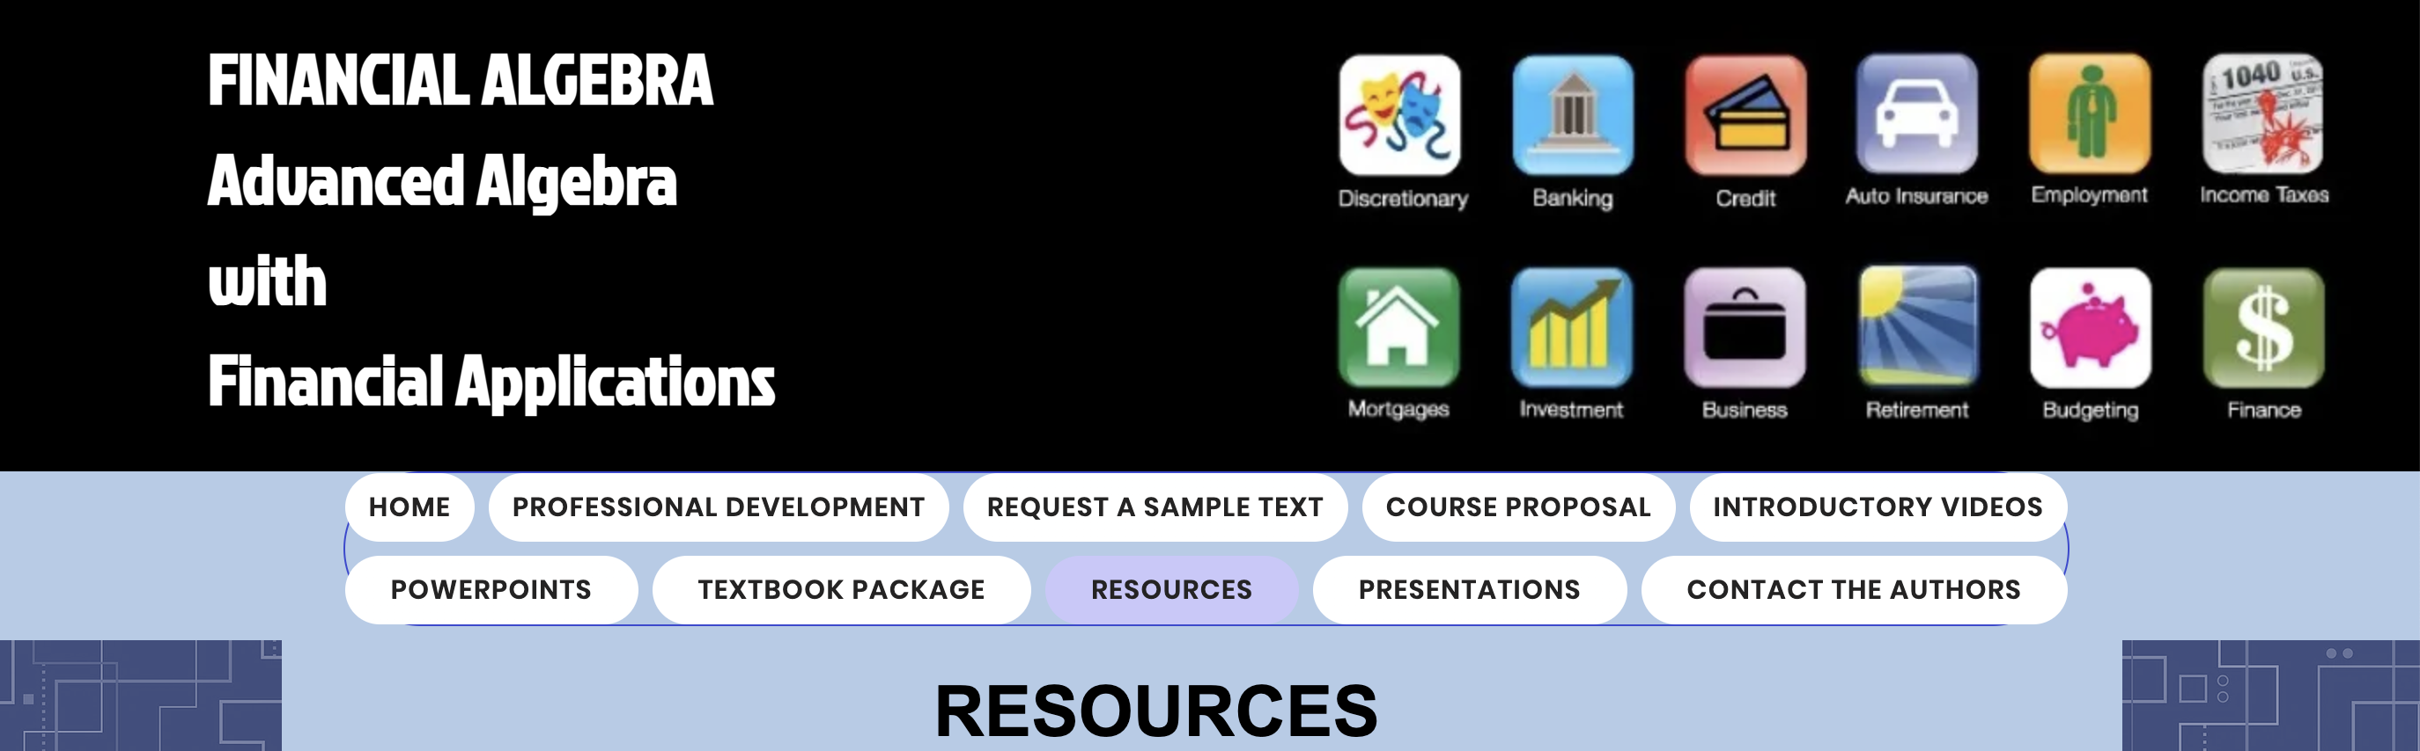



Download a copy of today’s presentation at
www.financialalgebra.com
Click on the RESOURCES link and scroll to the bottom for the session title. Click on it.
OCTM Annual Conference 2026 Sandusky OH
Financial Math vs Finfluencer Myth: Using Algebra-Based Financial Applications as Reality Checks
Click here to download this presentation.

Slide 3
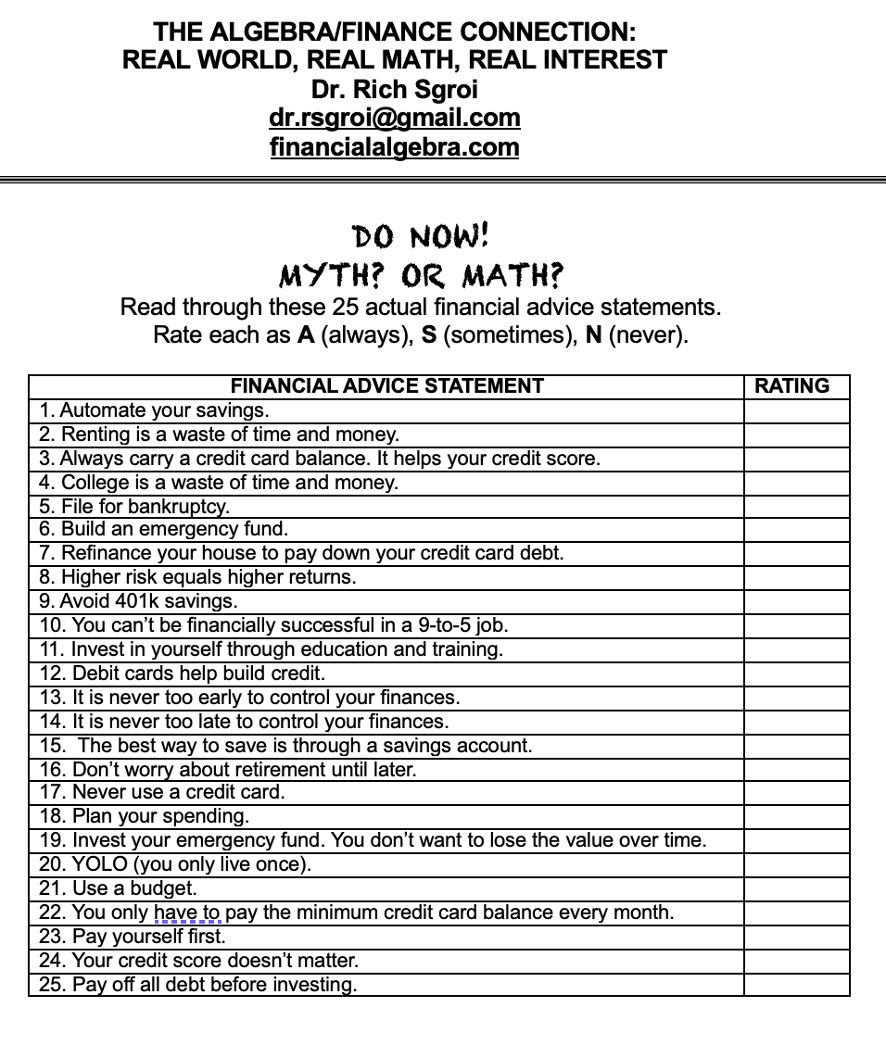
FINANCIAL ADVICE RATINGS

Slide 4

SOCIAL MEDIA FINANCIAL INFLUENCERS
“FINFLUENCER$”
“A finfluencer is a person who, by virtue of their popularity or cultural status, can influence the financial decision-making process of others through prommotions or recommendations on social media.”

Slide 5
SOCIAL MEDIA “FINFLUENCER$”
61% of young adults trust social media investing tips!!
Finfluencers don’t have the burden of correctness!
Finfluencers try to take a nuanced subject and boil it down to 57 seconds!
The quick-hit, social approach carries great risks!

Slide 6
FINANCIAL ADVICE RATINGS

Slide 7

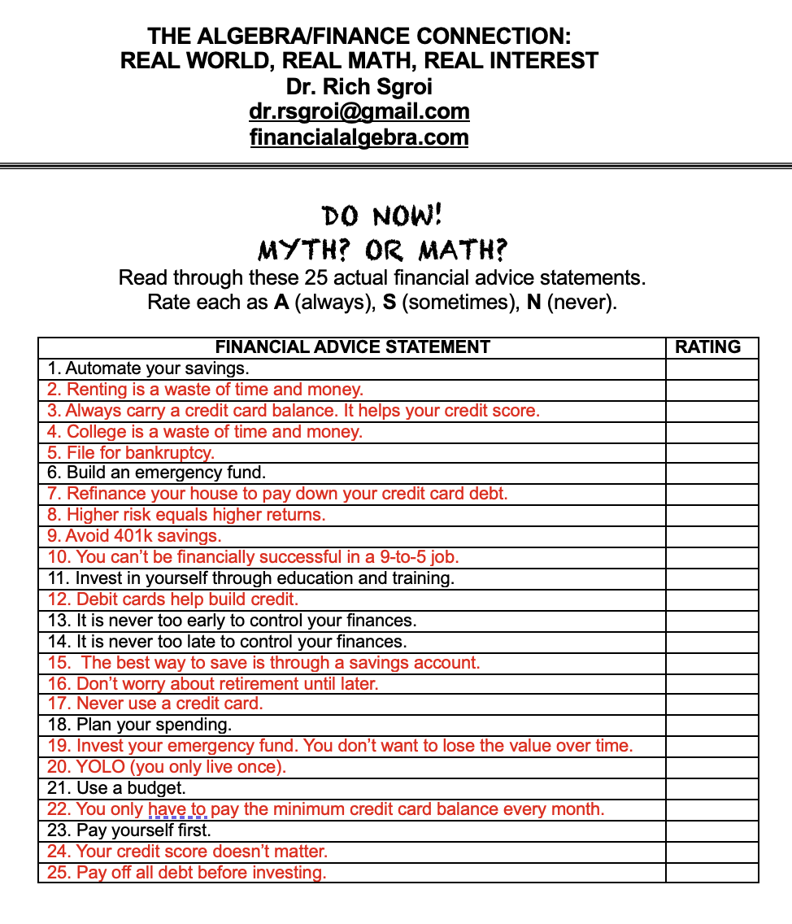

Slide 8


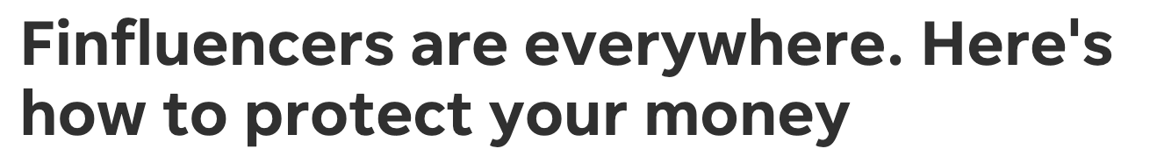
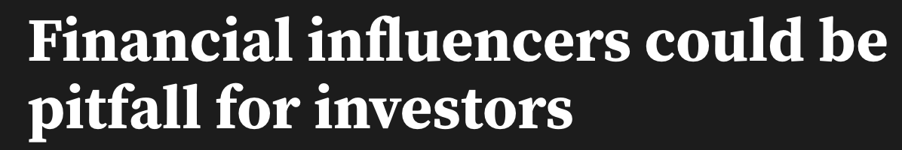

Slide 9

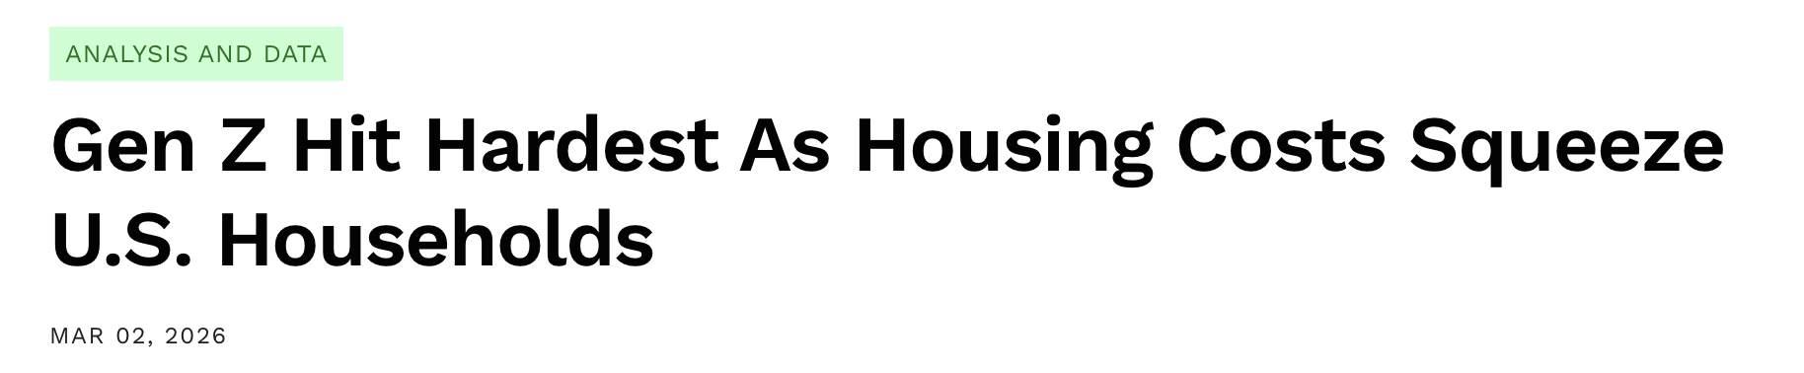
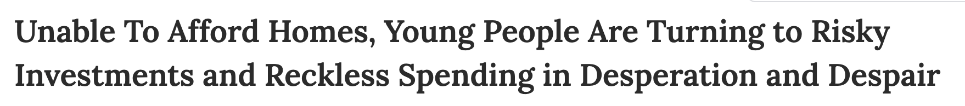

Slide 10







Slide 11


MARATHON
MORTGAGES

Slide 12


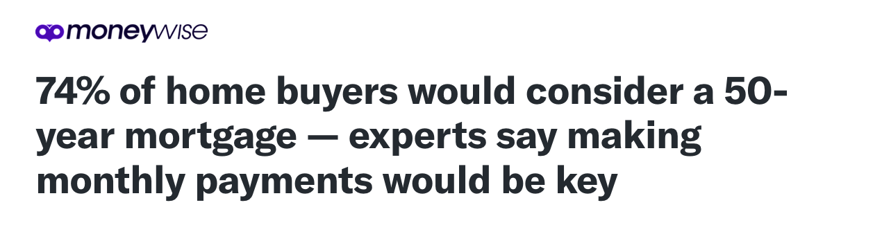

Slide 13

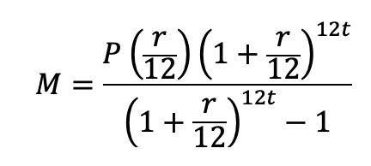
MONTHLY PAYMENT FORMULA
$350,000
$50,000 DOWN

Slide 14
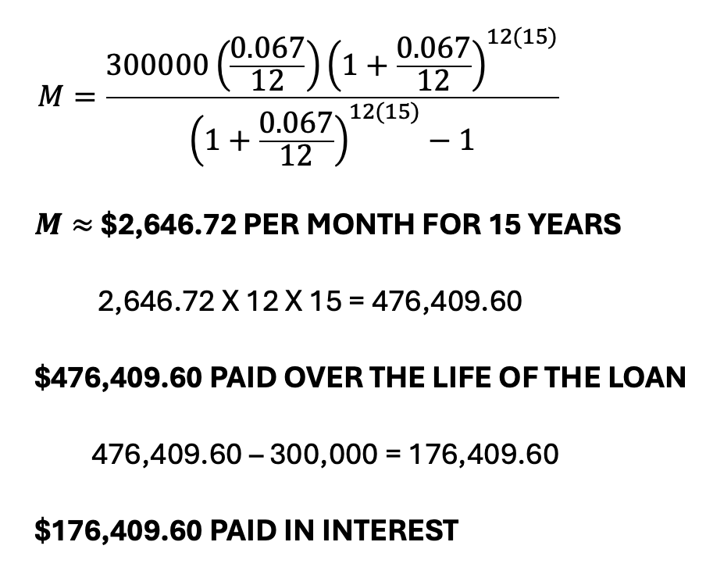
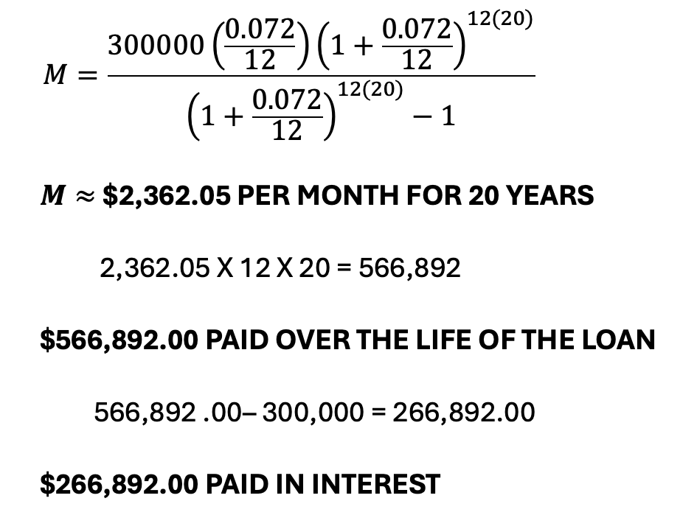
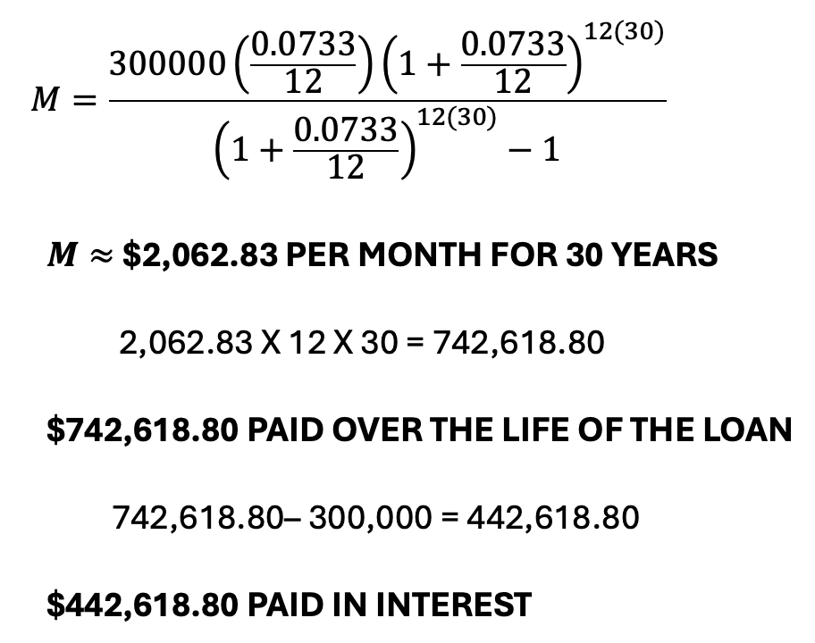
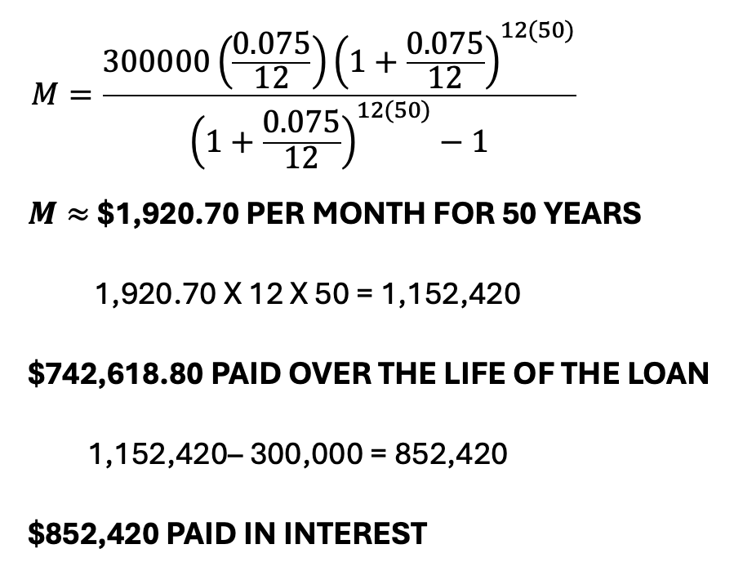
15 YEARS
20 YEARS
30 YEARS
50 YEARS

Slide 15
Extending the length of a loan just spreads the pain over more years. Longer mortgages might lower the monthly bill, but they multiply the total debt.

Slide 16

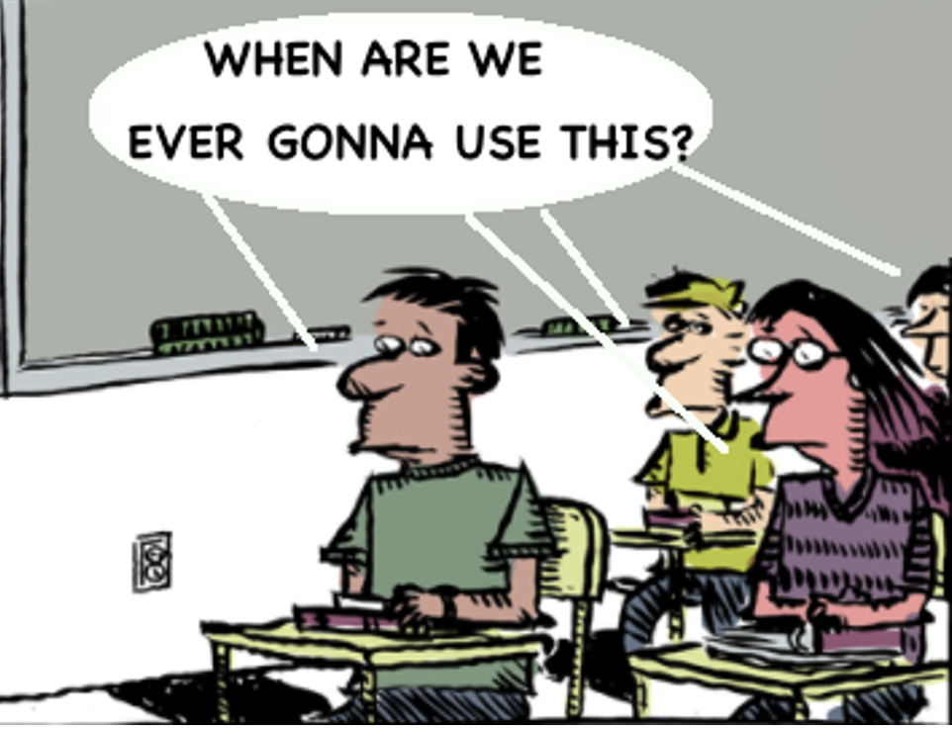

Slide 17
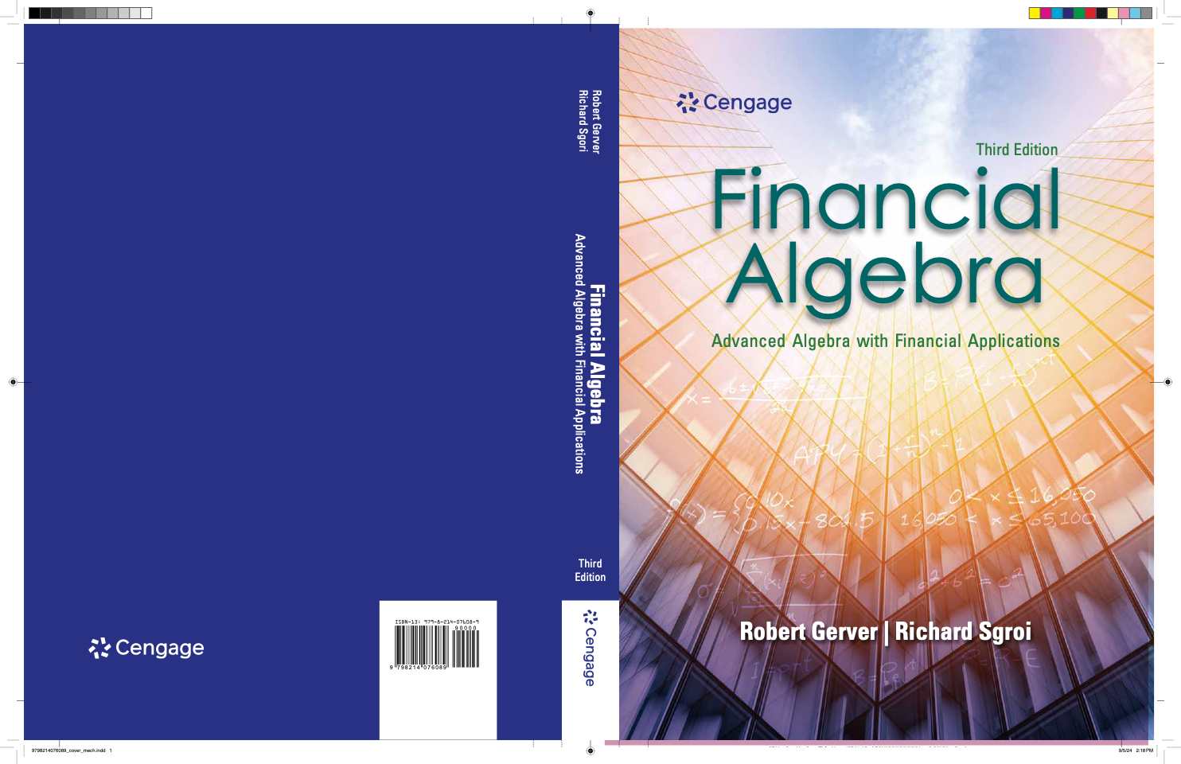
The information in this presentation that is excerpted from
Financial Algebra 3E
by Gerver and Sgroi
is used with permission from
National Geographic/Cengage Learning

Slide 18
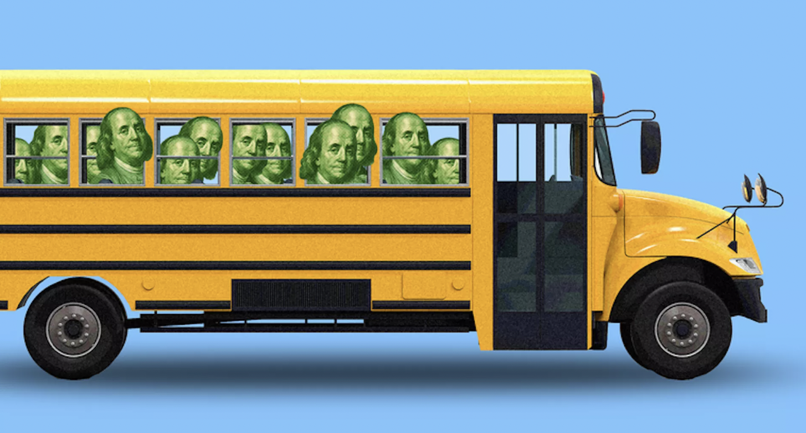
SESSION GOAL
TODAY’S GOAL.....
RECOGNIZE THAT FINANCIAL APPLICATIONS
HAVE THE POWER TO EMPOWER STUDENTS
STRANDED THROUGHOUT COURSES
THE FOCUS OF A HALF-YEAR COURSE
THE FOCUS OF A FULL-YEAR COURSE
THE FOCUS OF A COURSE MEETING FINANCIAL LITERACY REQUIREMENT

Slide 19
CONTEXT ANCHORS
“Carefully designed anchors help students learn techniques, facts and ideas in long-term and transferrable ways.”
-Cognition and Technology Group at Vanderbilt University
ANCHORS MUST FULFILL 4 REQUIREMENTS:
Capture the students’ imagination;
Be perceived as important by learners;
Legitimize the disciplinary content they utilize;
Accommodate a variety of learning approaches.
Financial context anchors give meaning
to the mathematical content!!

Slide 20

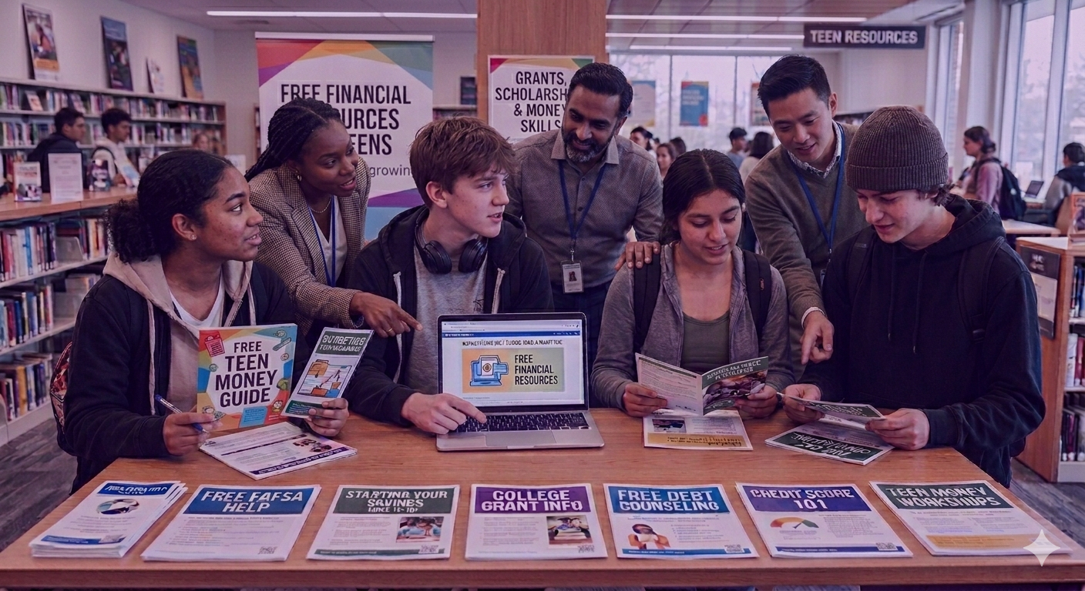
Let’s Look at
Some Key Resources

Slide 21
ALTERNATIVE ASSESSMENT PROJECTS
Price your own funeral
Price a new car
Interview an accountant
Price auto insurance
Interview a banker
Comparison shop loans
Build a clinometer
Interview a pharmacist
Price a wedding
Interview a stockbroker
Create a home inventory
Interview a stockbroker
Research failed inventions
Research patents and trademarks
Comparison shop supermarkets
Compare national vs. store brand
Price banking services
Research FICO scores
Interview insurance agent
Price and plan a road trip
Price car leasing
Research unemployment insurance
Price a home closing
Interview property tax assessor
Research failed inventions
Compare generic vs. name brand drugs

Slide 22
Key Ancillary Resources
www.FICYCLE.org
Statistical Abstract of the United States & US Census
www.MoneyExperience.com
theIMFoundation.org
www.reddit.com/r/dataisbeautiful
https://www.thetayf.com/
MyMoney.gov
www.annuity.org
handsonbanking.org/
nefe.org
foolproofme.org
Stockmarketgame.org
takechargetoday.arizona.edu/
Napkinfinance.com
www.financialalgebra.com
www.jumpstart.org
Financial Algebra textbook
www.ngpf.org/courses/financial-algebra-course
NGPF and Jump Start free Online Professional Development
Federal Deposit Insurance Corporation
Federal Reserve Bank
New York Stock Exchange

Slide 23

QUANTITATIVE
FINANCIAL MODELING
AN IMMERSION APPROACH

Slide 24
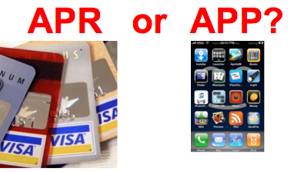
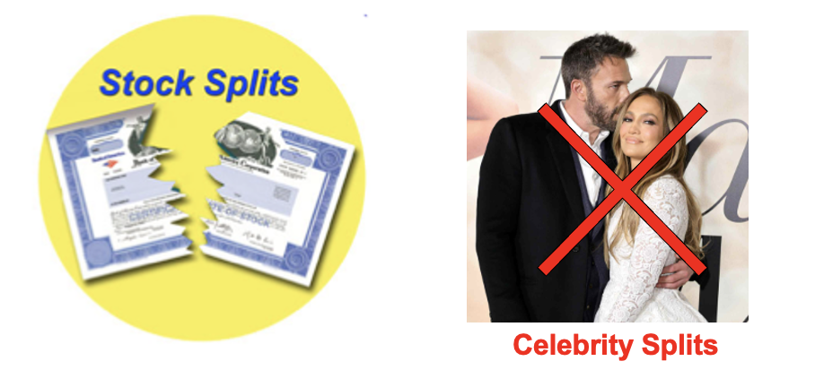



WHICH ARE YOUNG ADULTS
LIKELY TO KNOW MORE ABOUT?
iRS or iRA or iPhone

Slide 25

A DIFFERENT POINT OF VIEW
ABOUT MATH PEDAGOGY, CONTENT, AND STUDENT ENGAGEMENT

Slide 26

“Never try to walk across a river because it has an average depth of four feet!”
“Budget: a mathematical confirmation of your suspicions.”
“Someone is sitting in the shade right now because someone planted a tree a long time ago!”
“If the automobile had followed the same development cycle as the computer, a Rolls Royce today would cost $100 and get a million miles per gallon.”
To make a million, start with $900,000!
“The best way to double your money is to fold it over and put it in your pocket!”
QUOTEGARDEN.COM

Slide 27
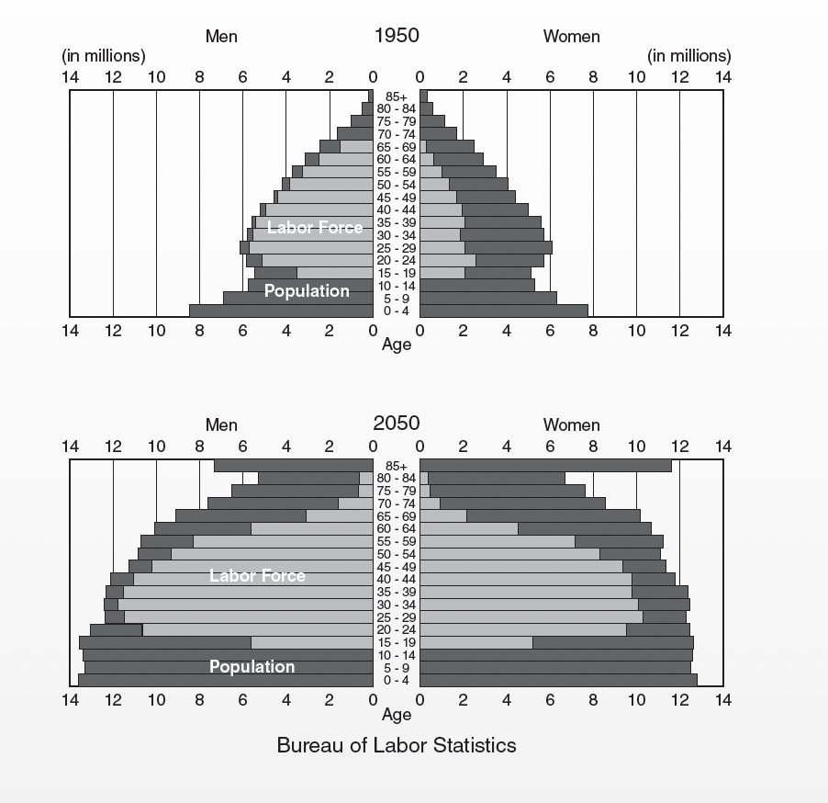
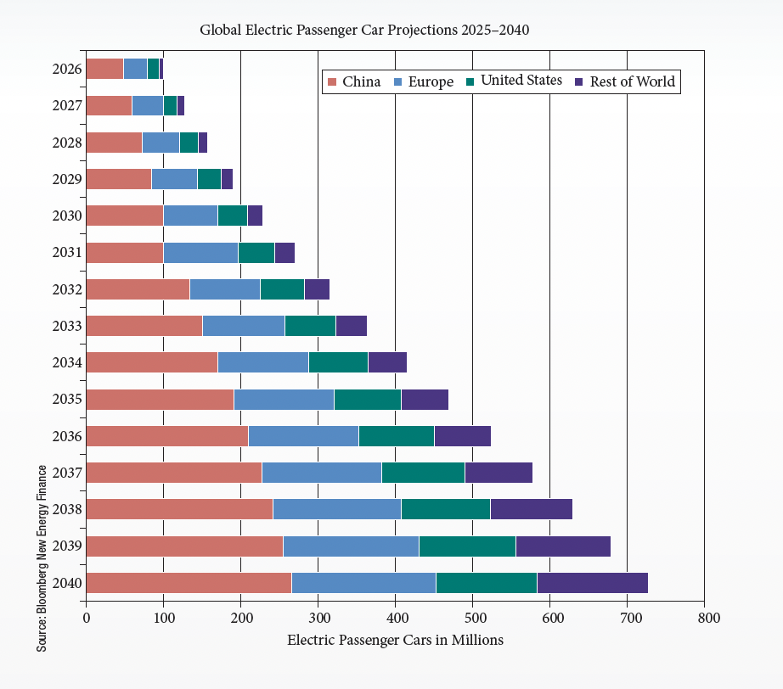
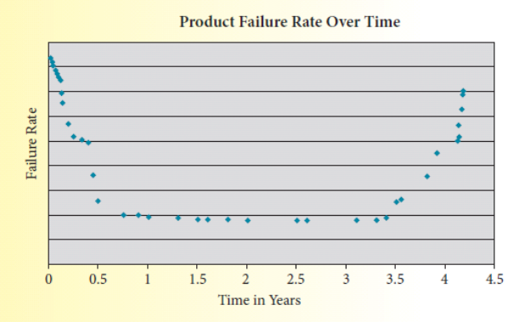
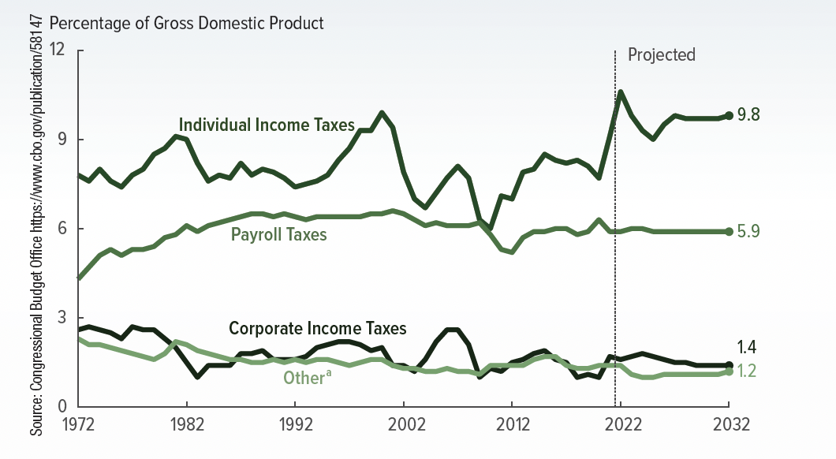
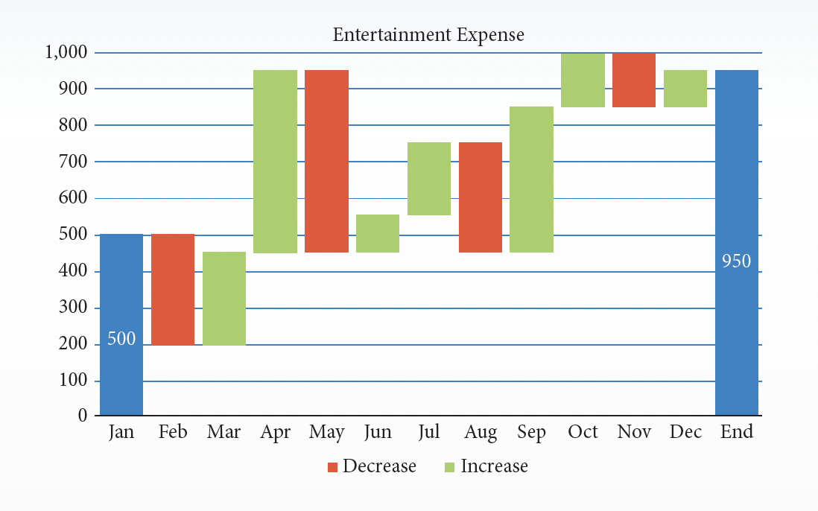
YOU WRITE THE STORY!!
Write a short news-type article centered on the data pictured in the graphs.

Slide 28
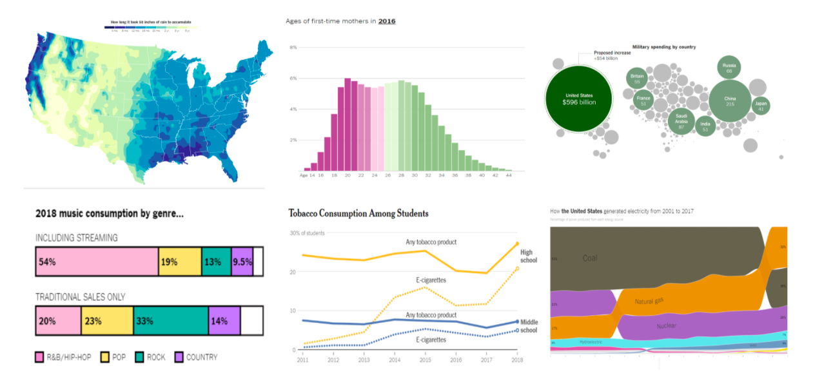
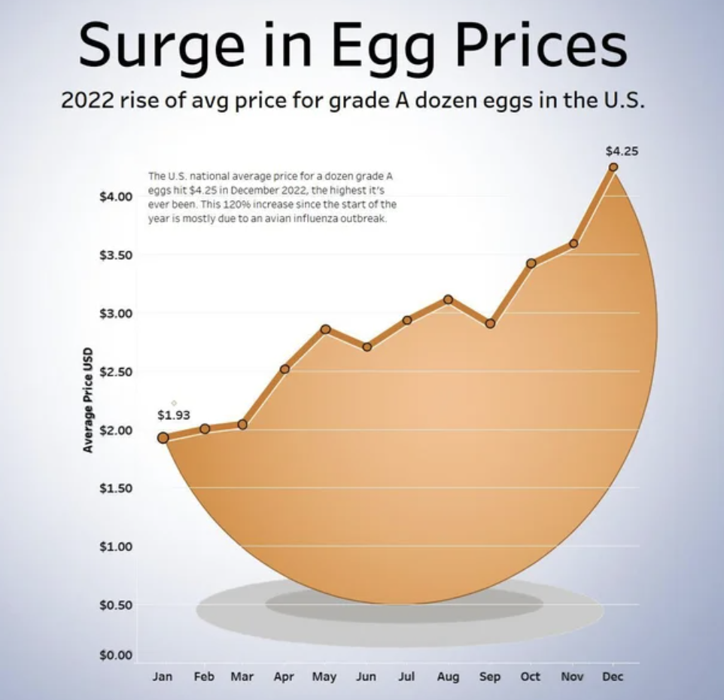
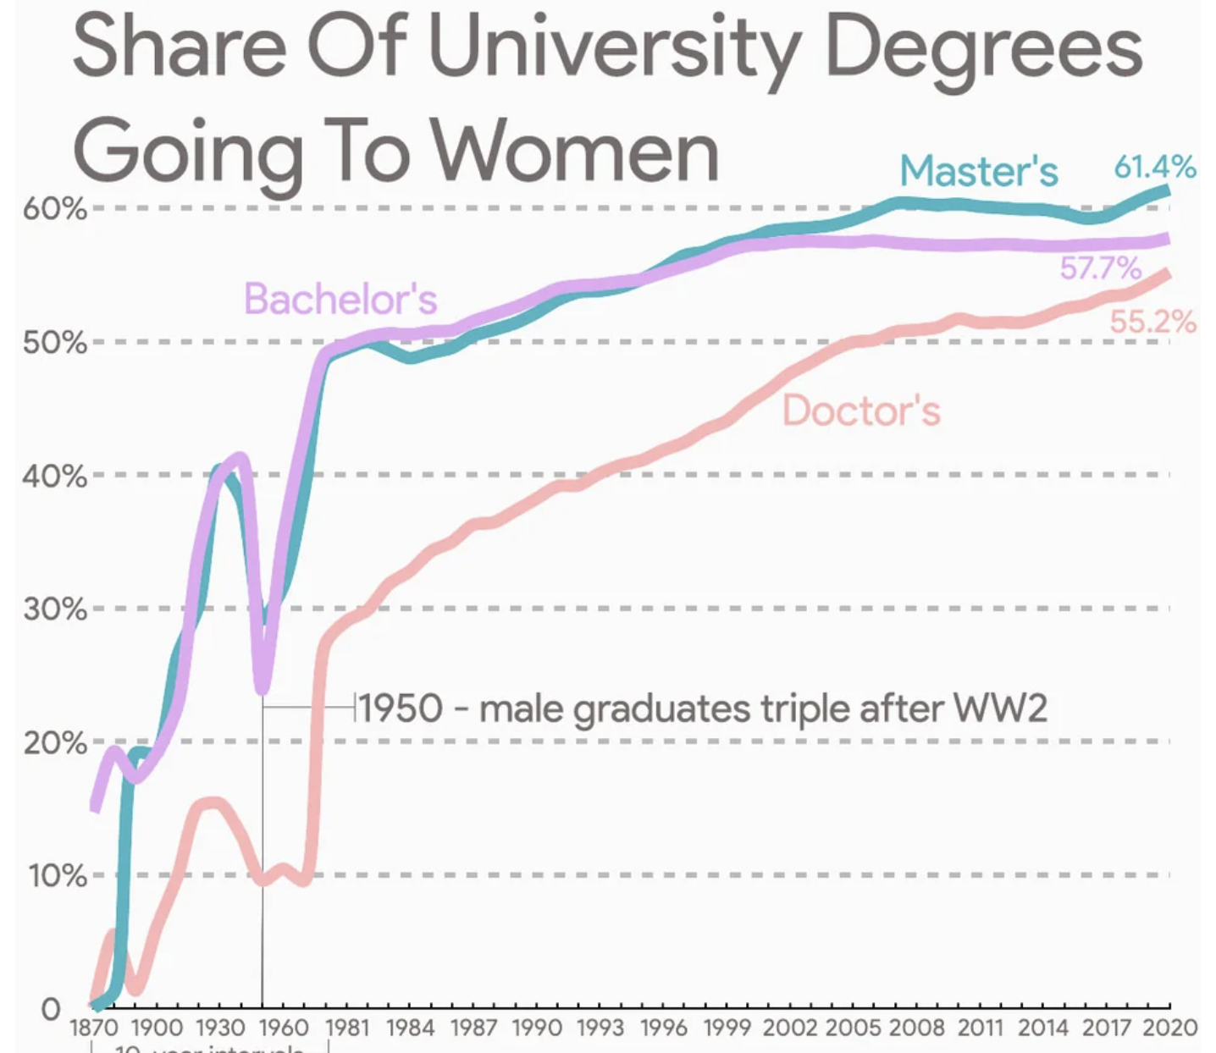
Graphs
and
Real-Life Data Aplications
at
reddit.com/r/dataisbeautiful
nytimes.com/column/whats-going-on-in-this-graph

Slide 29

Let’s look at how the finance topics drive the math
and
the math topics
drive the finance so that students don’t fall prey to bad advice!

Slide 30



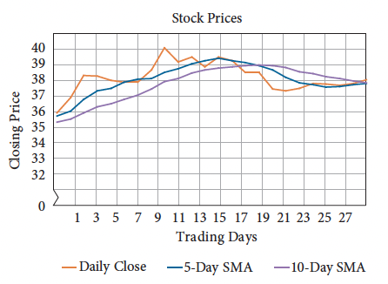
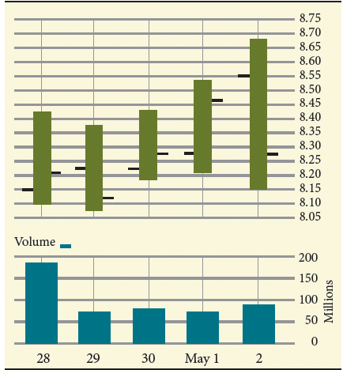
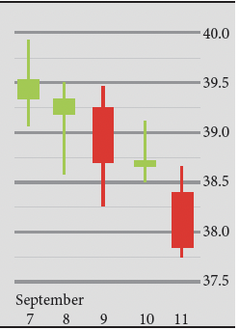
Wait for the absolute market bottom to buy!
Buy what is trending on social media!
Never buy when the economy looks bad!
Hold everything forever!
Flip stocks daily or weekly for quick income!
Sell the second a stock drops 5 – 10%!
Can Historical Stock Market Data Inform Future Trends?

Slide 31
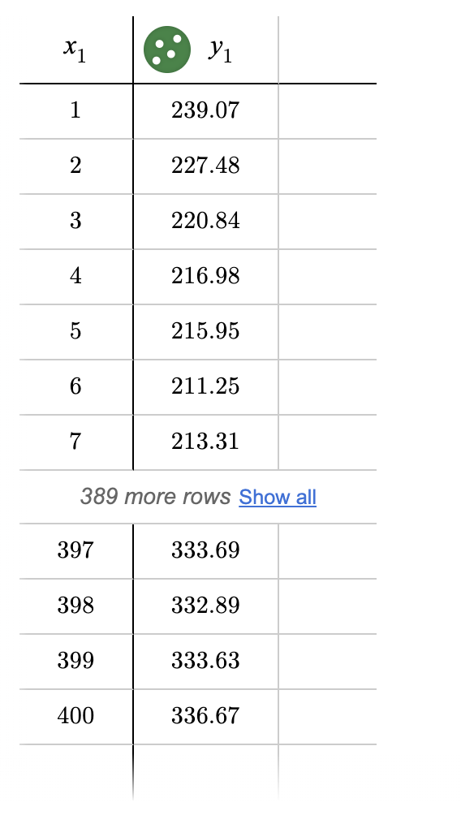



400 CLOSING PRICES
finance.yahoo.com

Slide 32
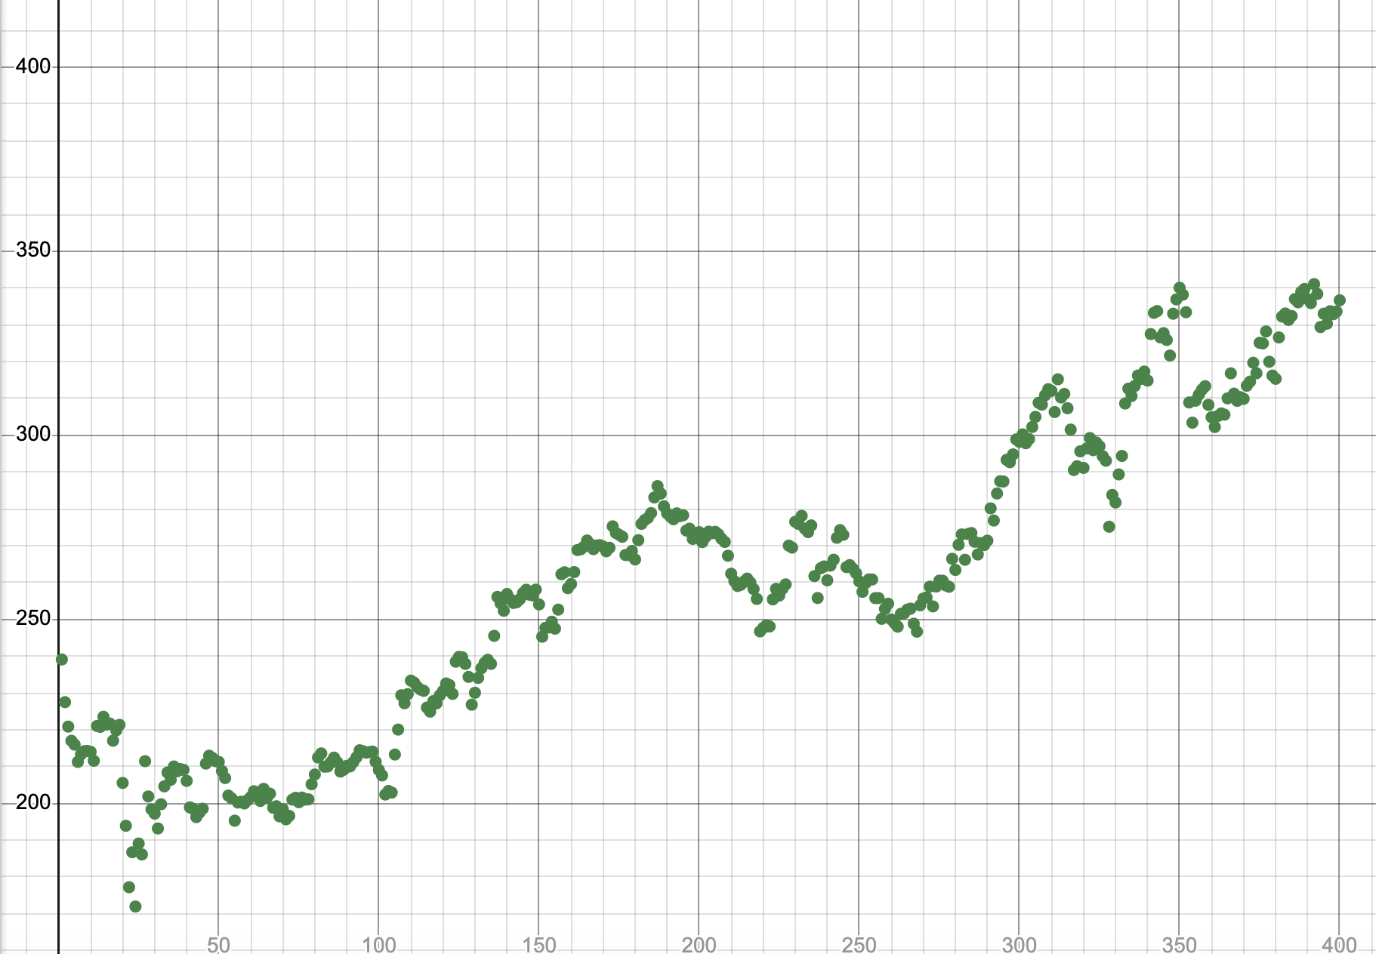

Slide 33
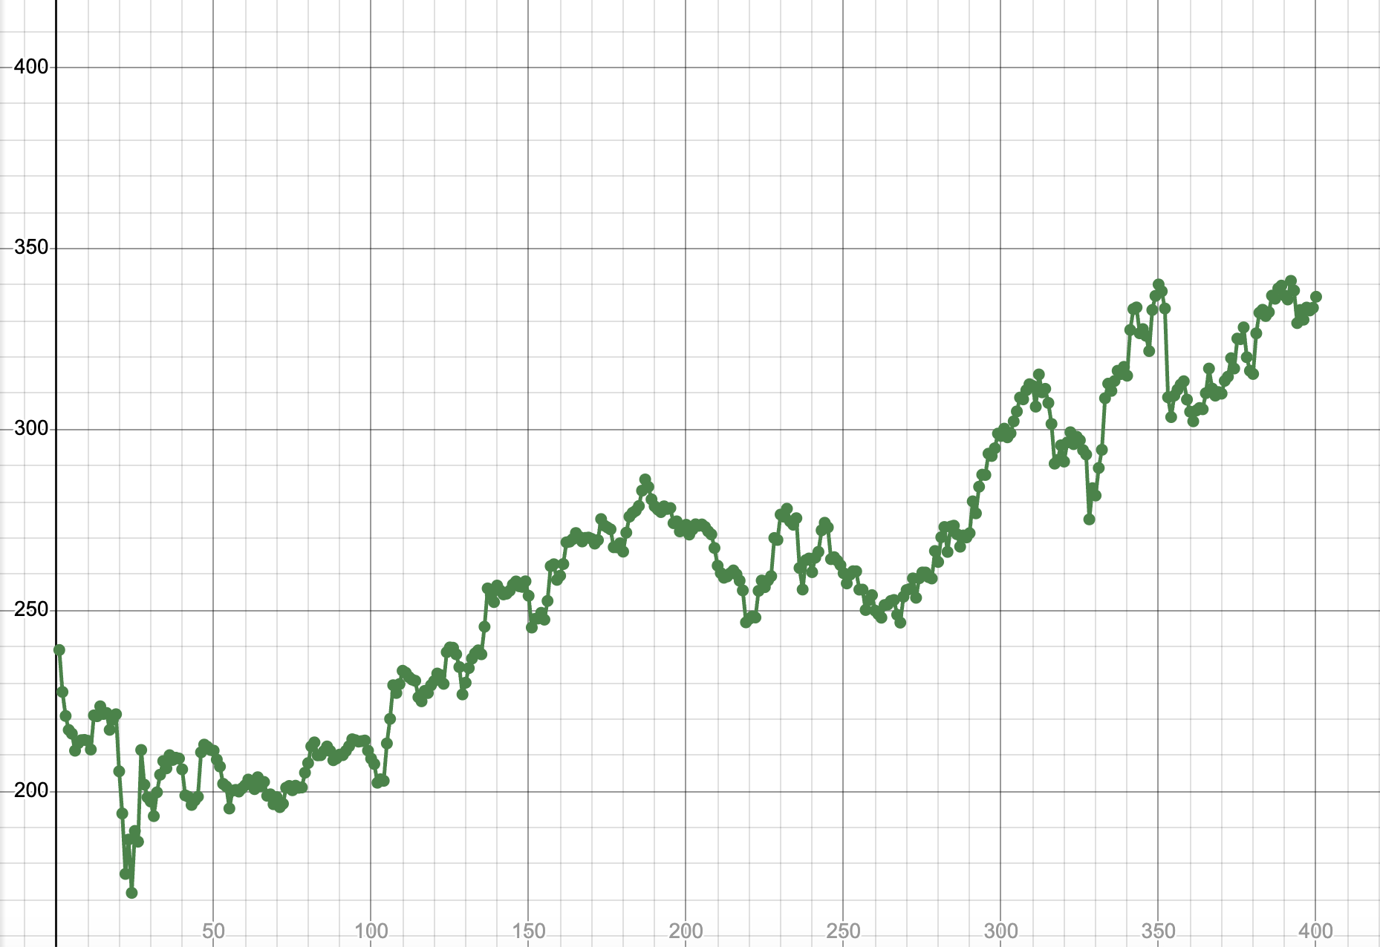

Slide 34
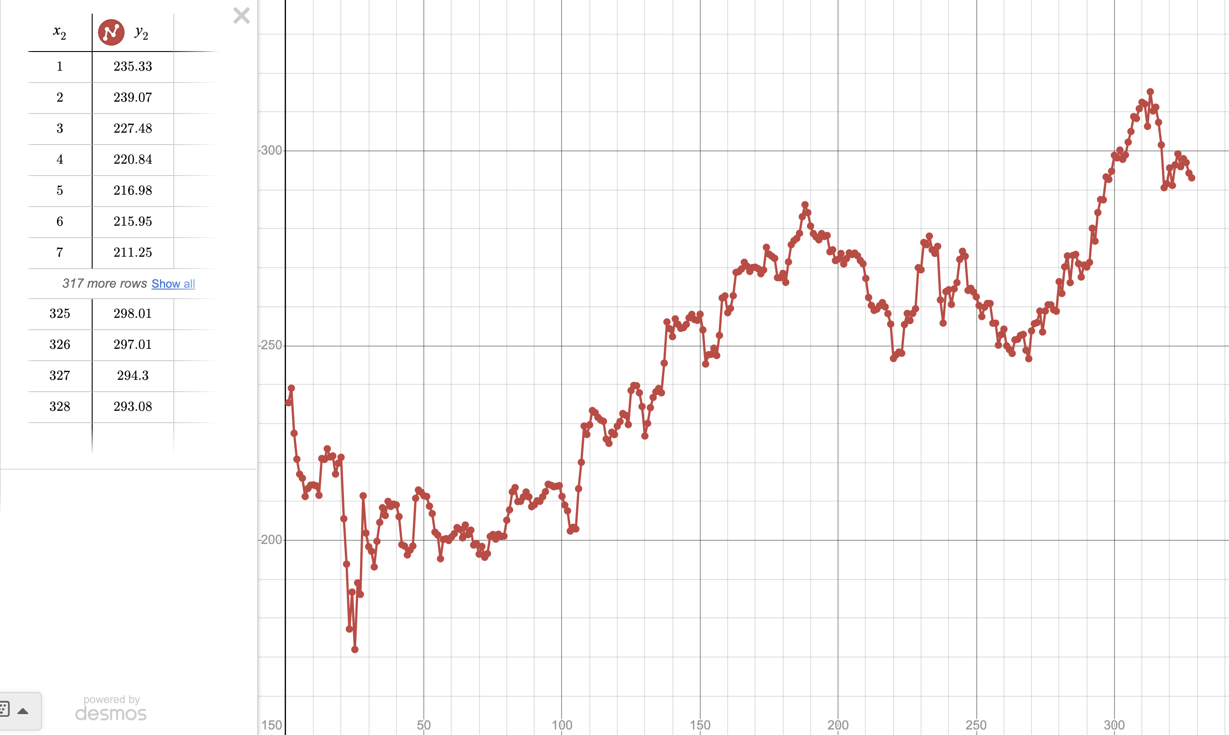

Slide 35
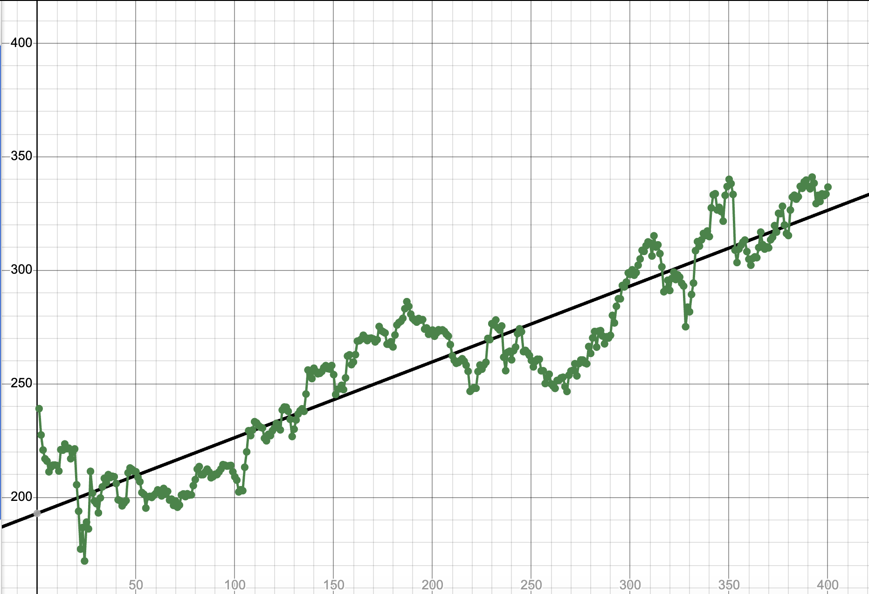
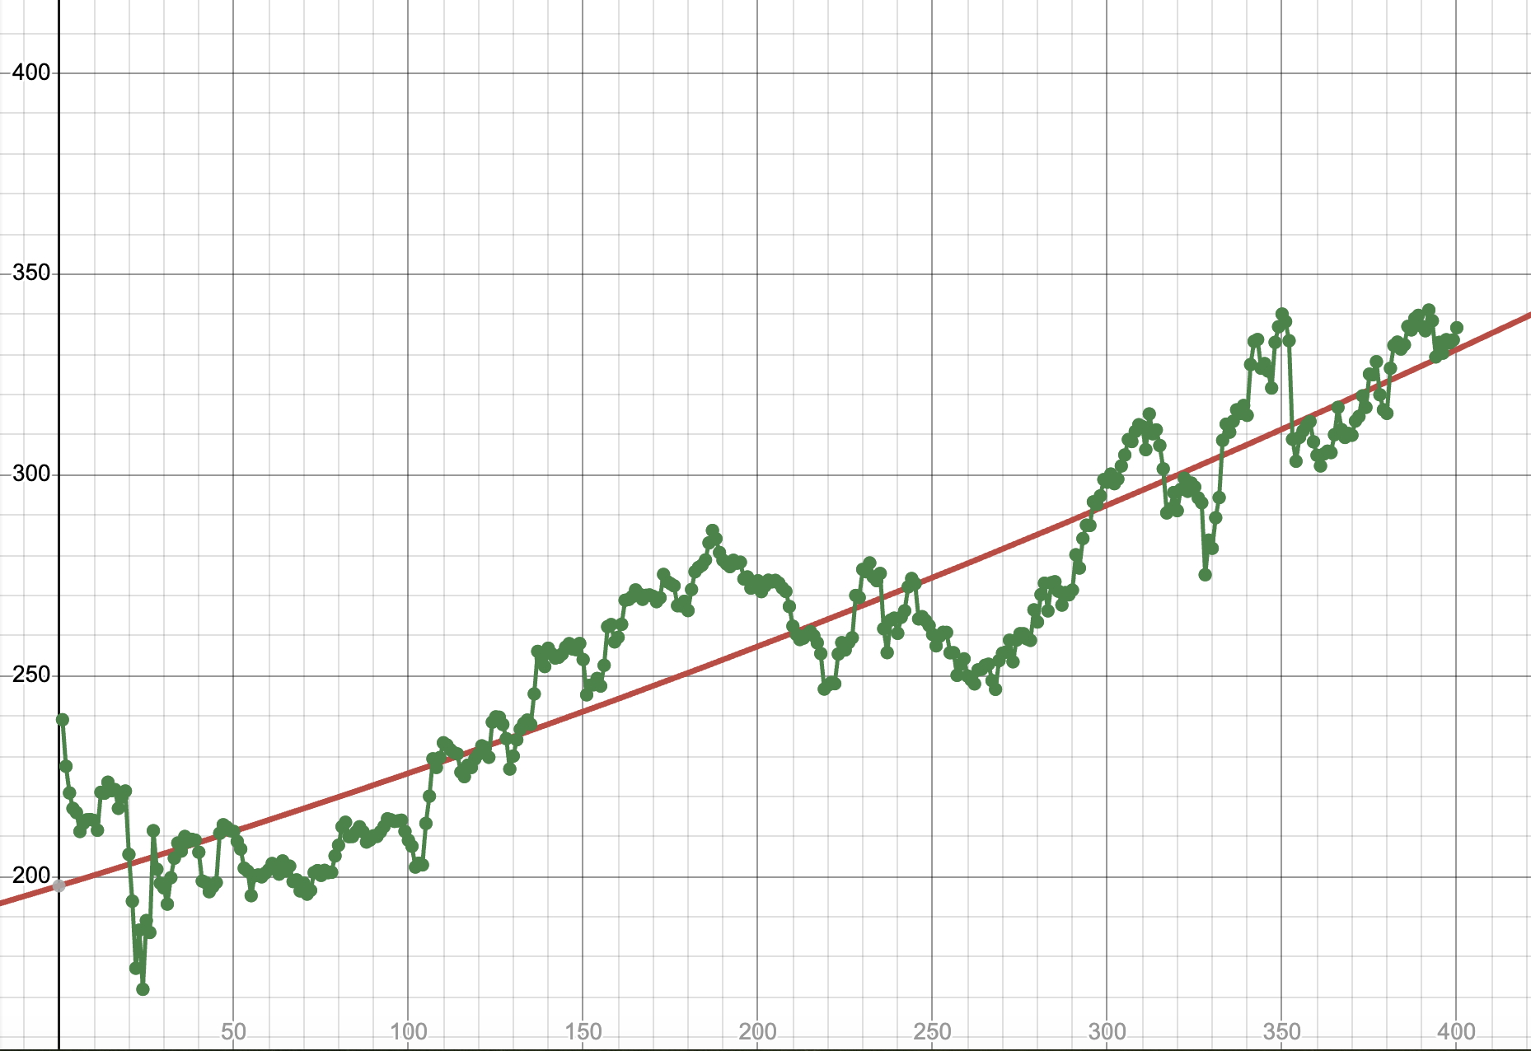
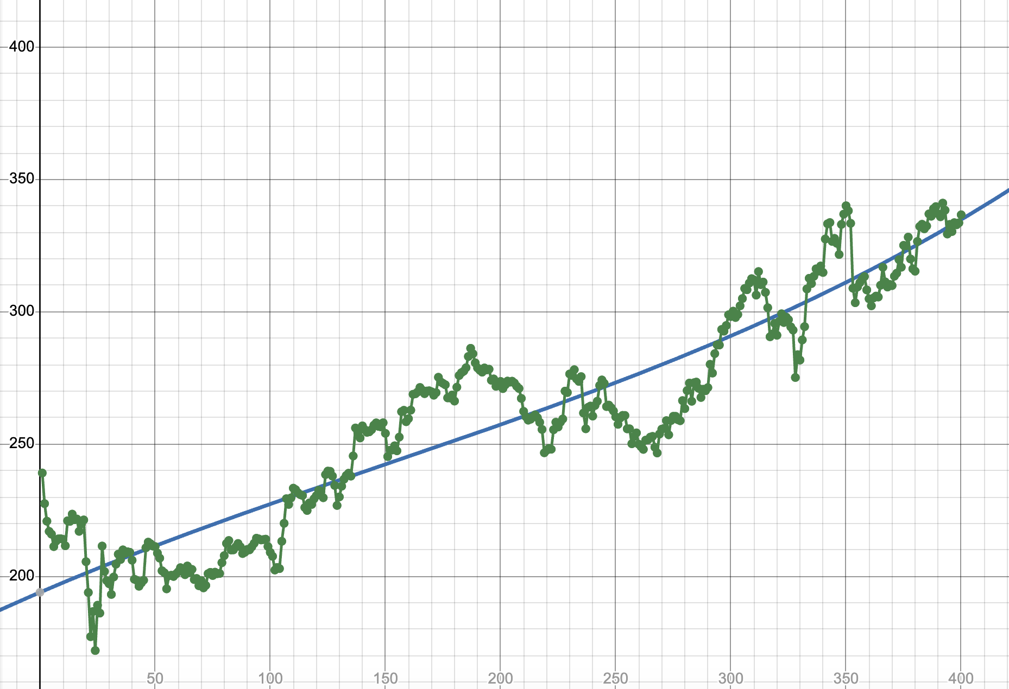
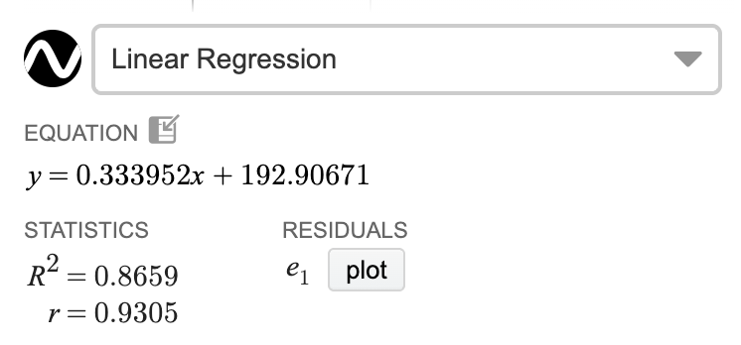
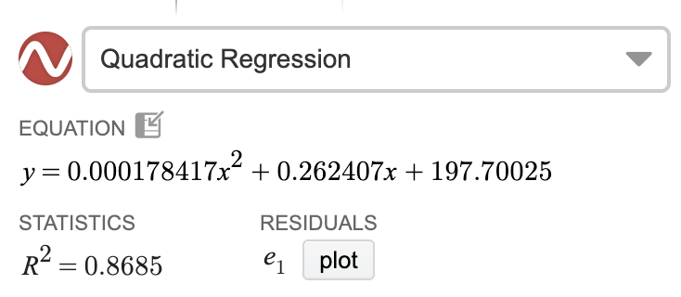
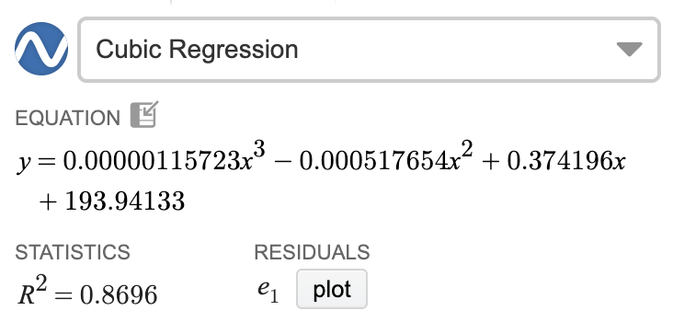
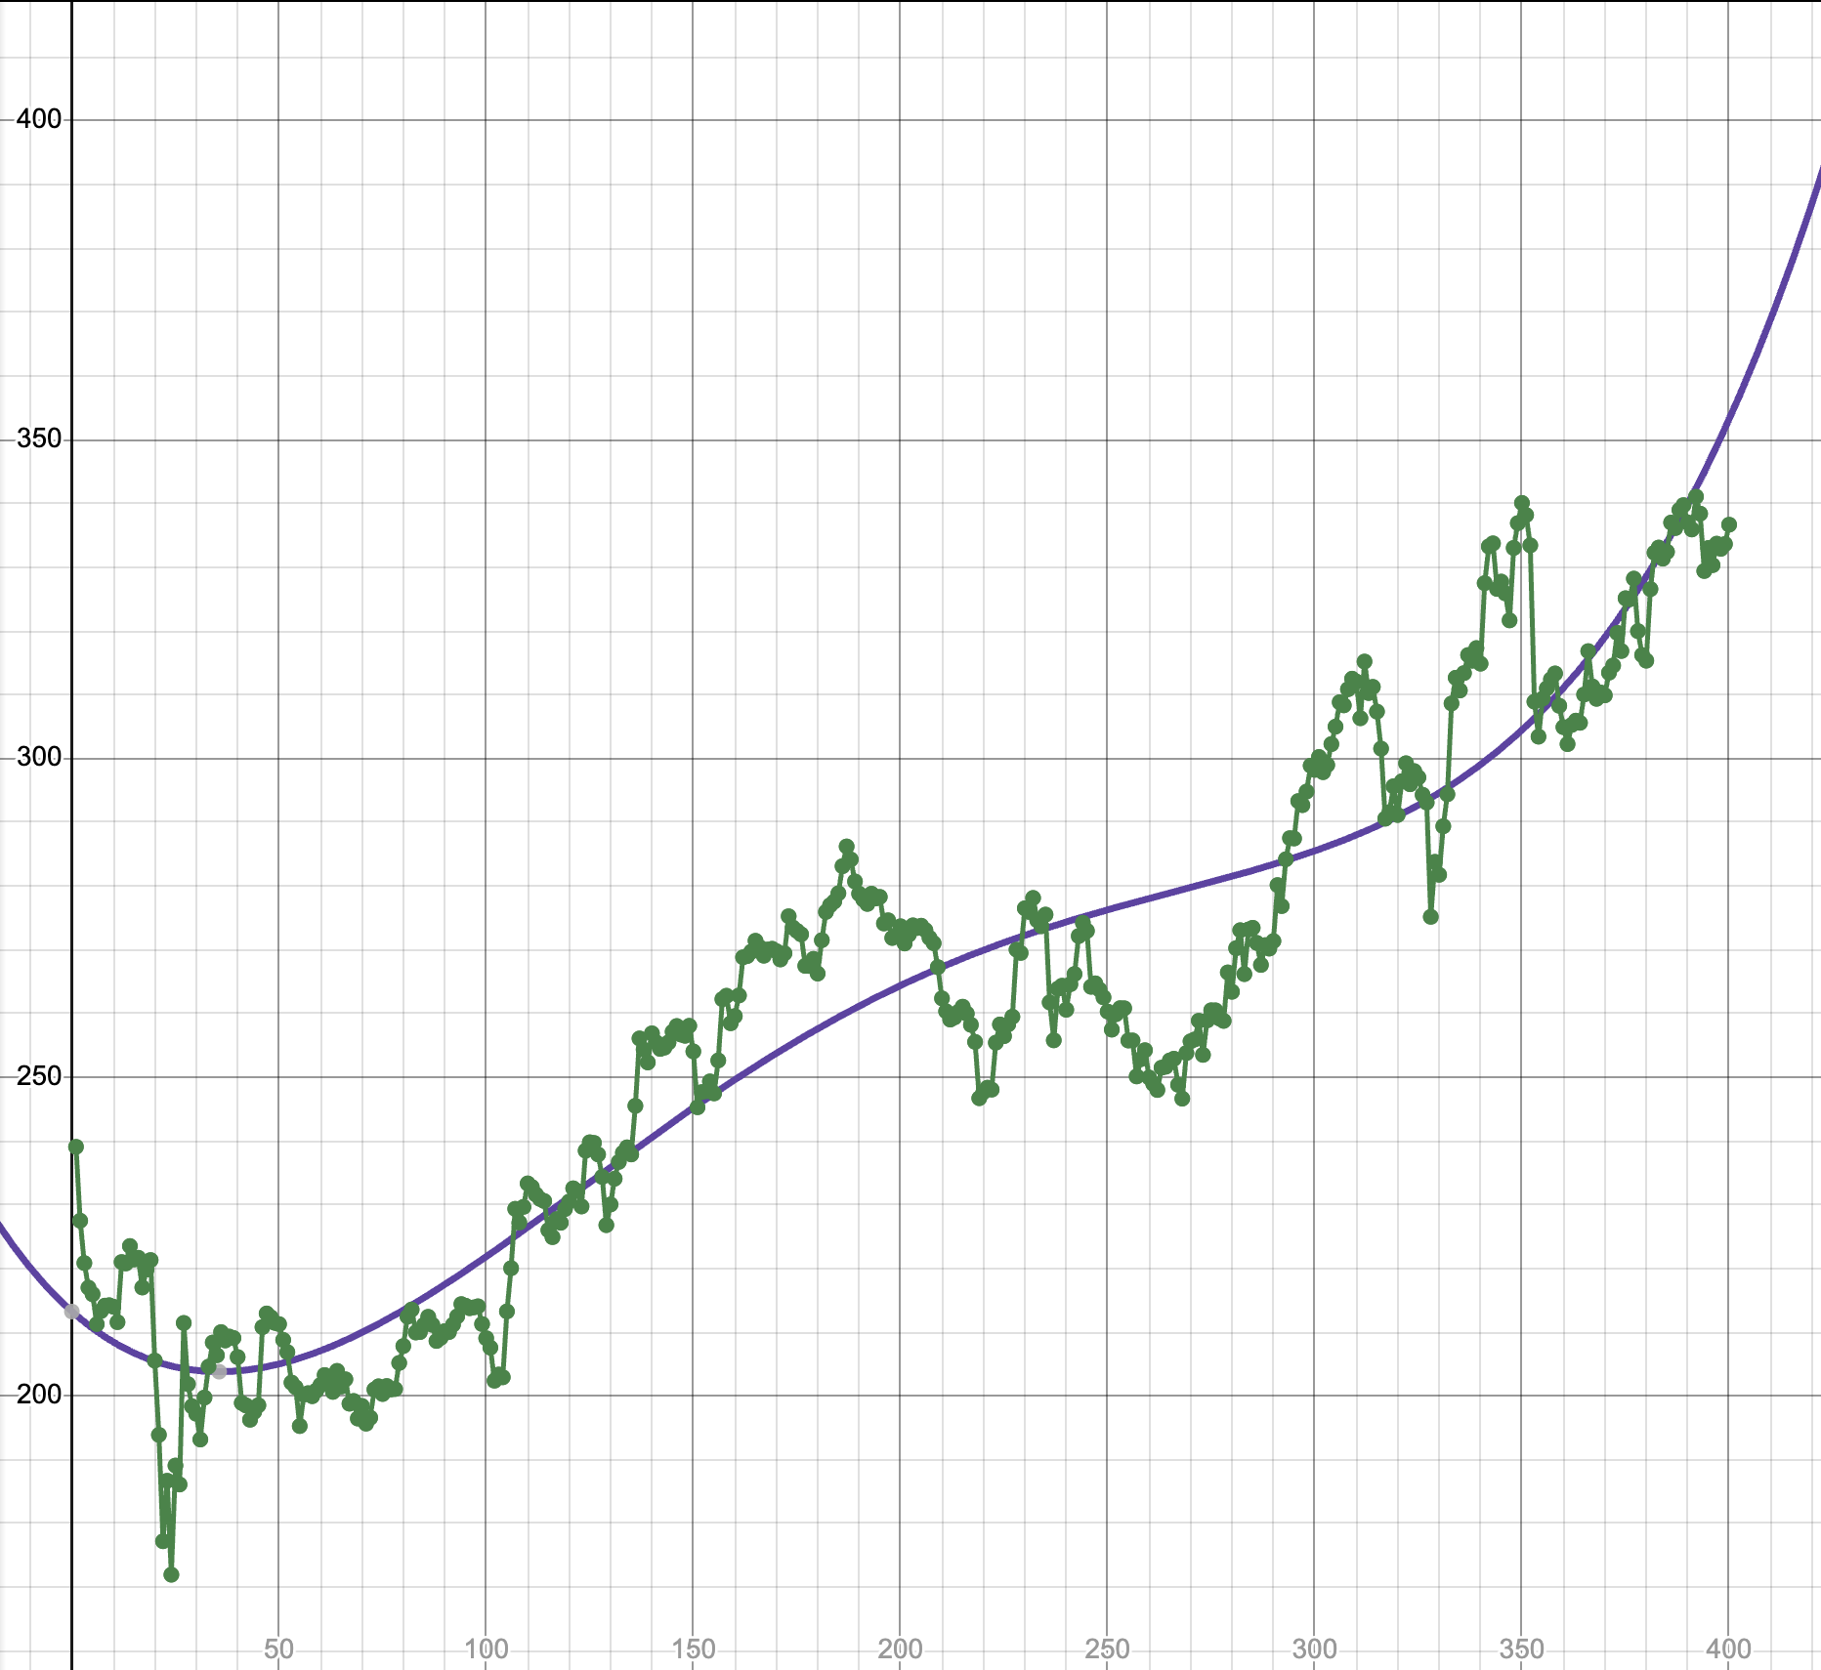
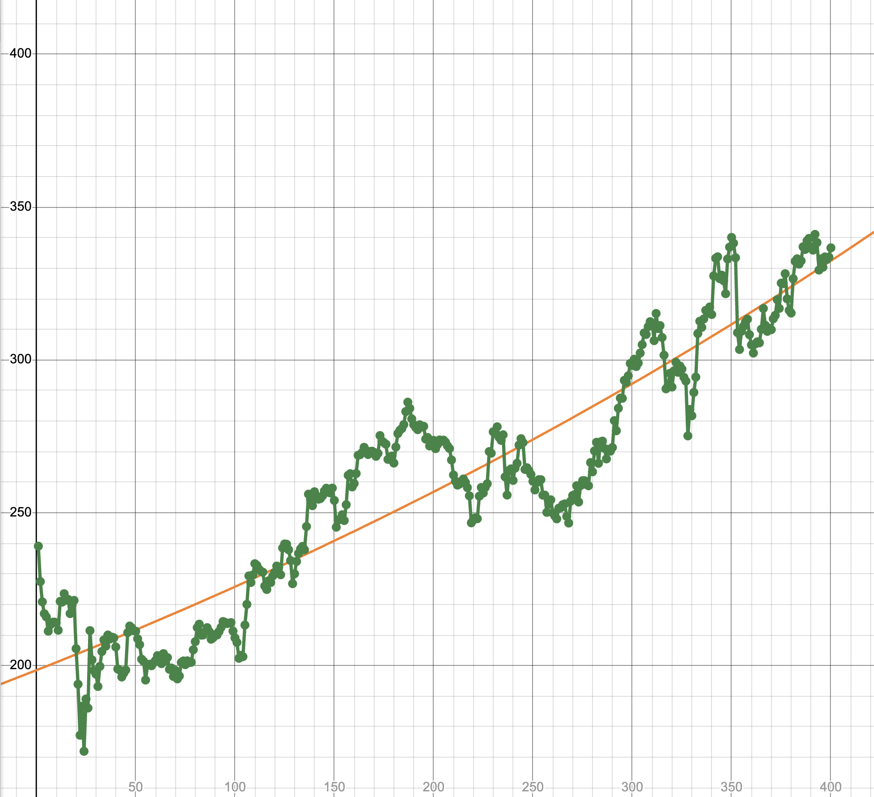
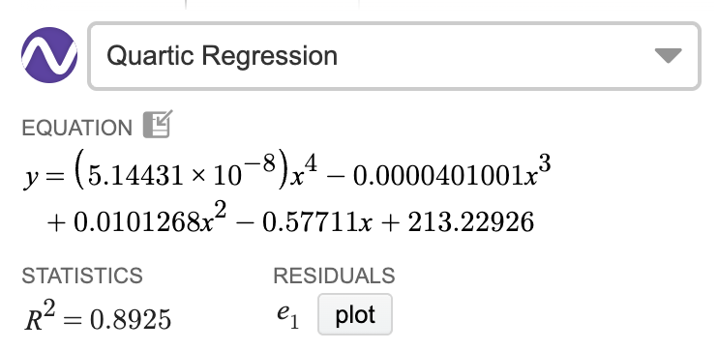
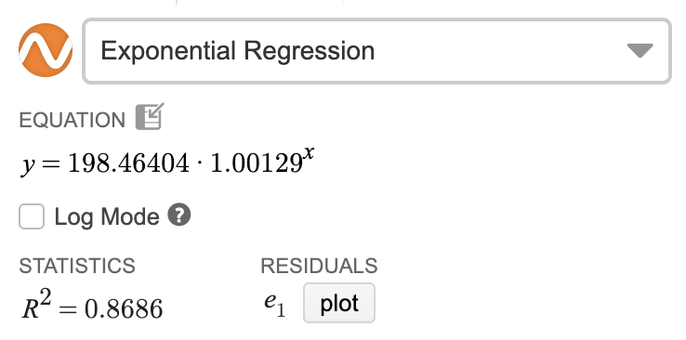
LINEAR
QUADRATIC
CUBIC
Predictions for
AAPL 329th Day
Closing Price 10/08/26
QUARTIC
EXPONENTIAL
F(x): linear
F(401) = $326.82
H(x): quadratic
H(401) = $331.61
J(x): cubic
J(401)= $335.37
K(x): quartic
K(401) = $354.56
ACTUAL 401th Day CLOSING PRICE:
$340.42
L(x): exponential
L(401) = $332.83

Slide 36
VALUE OVER TIME
How does your car appreciate/depreciate?

Slide 37

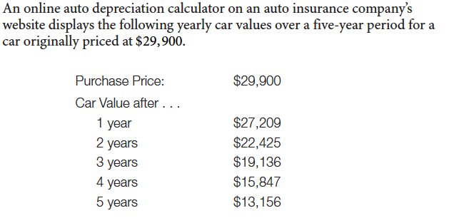
“A 2 – 3 year old used car always saves you the most money. Let someone else suffer the initial depreciation!!!”
9%
17.6%
14.7%
17.2%
17%

Slide 38
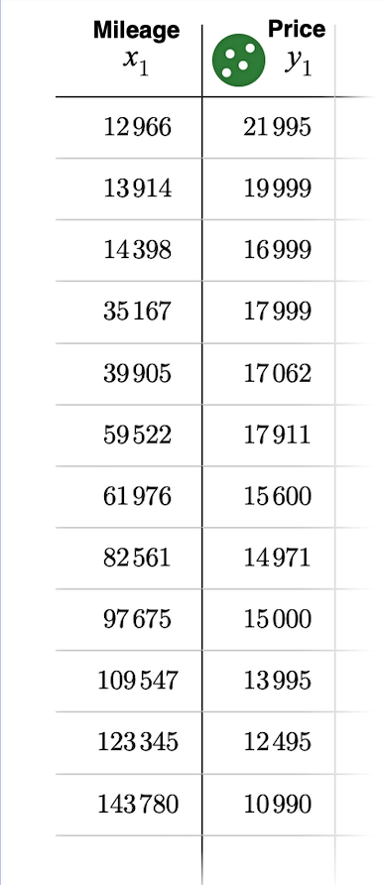
What Role Can Statistics Play in Negotiating an Automobile Transaction?
Megan is looking for a used 2024 Chevy Malibu and finds these prices for cars in the same condition with similar accessories.

Slide 39

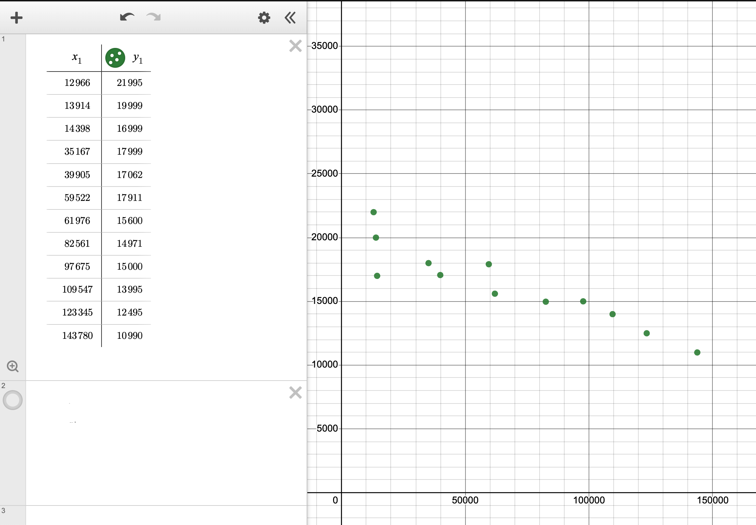

Slide 40
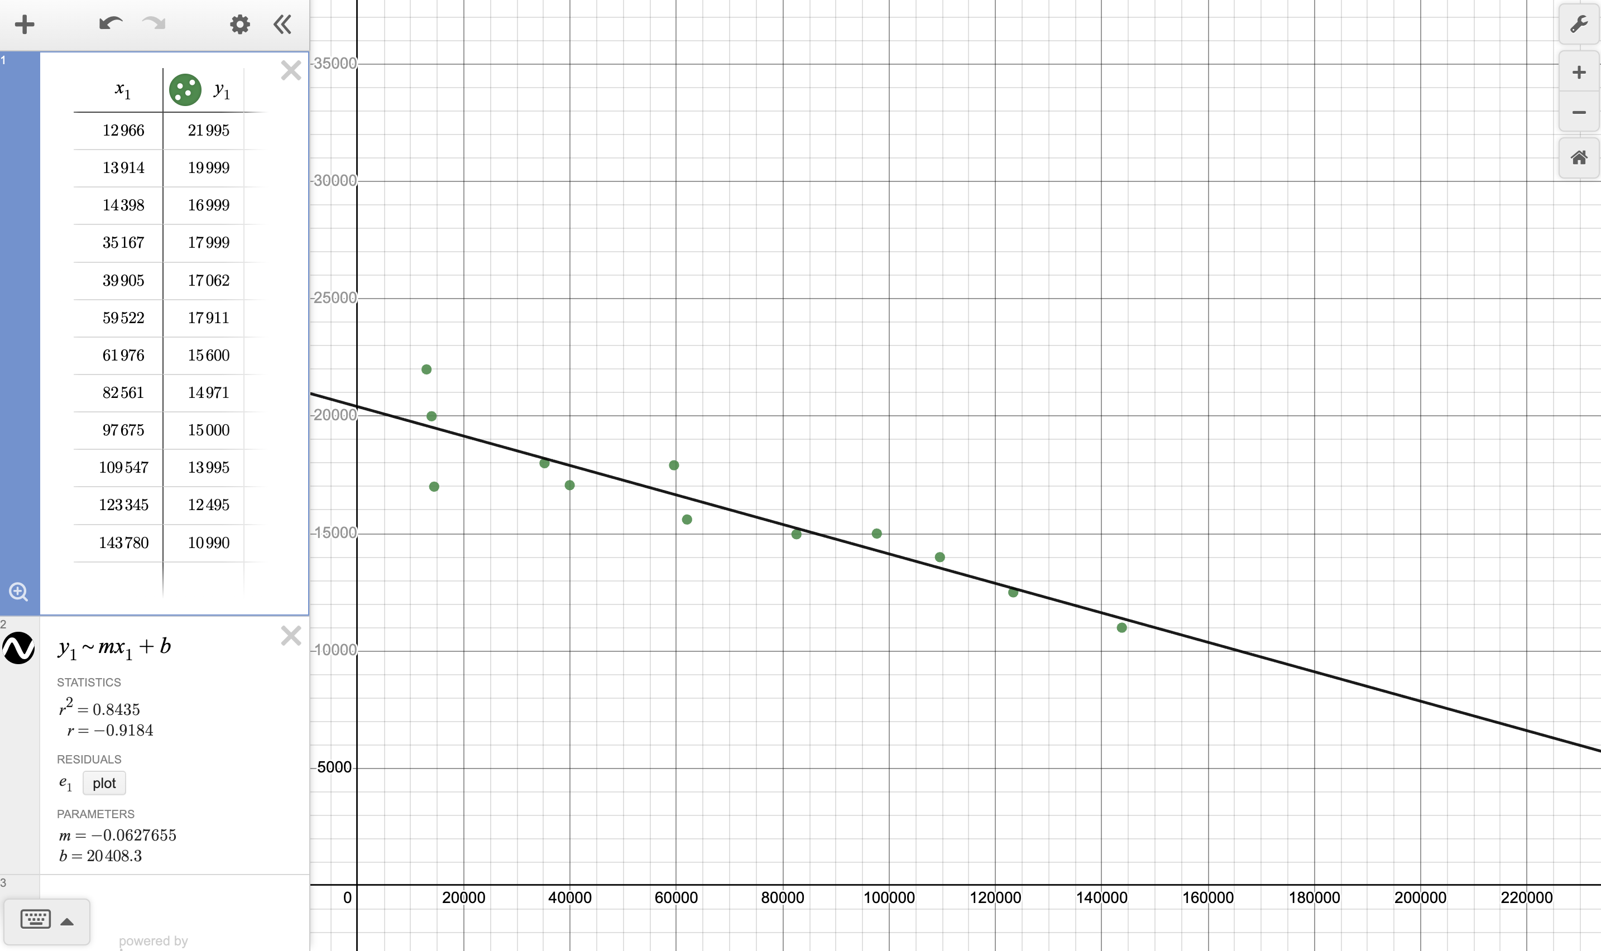
y = -0.0627655x + 20,408.3

Slide 41
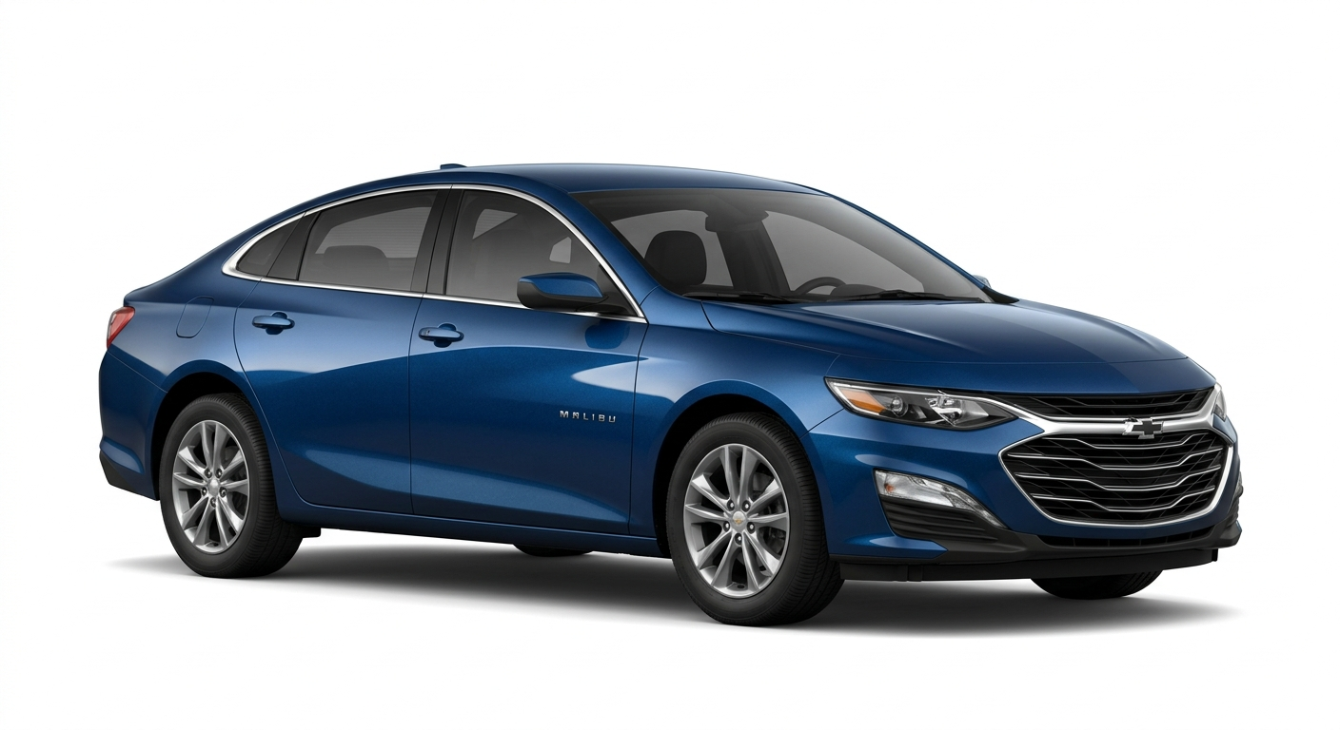
USED
2024 Chevrolet Malibu
45,001 miles
$17,990

Slide 42
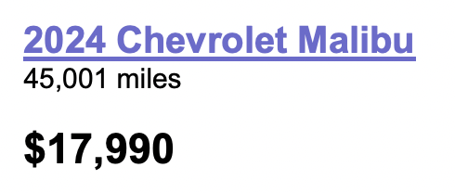

y = -0.0627655x + 20,408.3
When x = 45,001
y $≈$ $17,583.78

Slide 43


Slide 44

AUTOMOBILE EXPENSE & DEPRECIATION
$

Slide 45

PROBLEM SOLVING
THROUGH
PROBLEM POSING
What’s The Problem?

Slide 46

What’s The Problem?
Students are given a solution and have to write a word problem associated with a particular context.
CONTEXT: Automobile Depreciation
MATHEMATICAL TOPIC: Exponential Decay
Exponential Decay Formula
Annie bought a car for $24,000. Based on her research, she knows that this make and model depreciates at 5.5% per year. What will her car be worth in 4 years?

Slide 47

AUTOMOBILE EXPENSE & DEPRECIATION

Slide 48


AUTOMOBILE DEPRECIATION
Bath Tub Curve
Car Value in Dollars
x₁ x₂
Time in Years
What’s the story when 0 ≦ x ≦ x₁
x₁ ≦ x ≦ x₂
x ≧ x₂ ?

Slide 49





Slide 50
Buy an expensive EV to immediately stop wasting money on $4.50/gallon gas!
EV vs GAS-POWERED IS AN INDIVIDUALIZED DECISION! EACH PERSON NEEDS TO
DO THE MATH BASED ON THEIR OWN SITUATION.

Slide 51



HOW DO YOU COMPARE?
The average fuel consumption The average electricity consumption
efficiency of a gas-powered efficiency of an electric-powered
vehicle (MPG) vehicle (MPGe)
How many gallons of gas used in
100 miles?
100/34 approx. 2.9 g
How many KwH of electricicty used in
100 miles?
3370/99 approx. 34 KwH
$

Slide 52



APR APY
An account with 5% APR is exactly the same as an account with 5% APY!
COMPOUND INTEREST FORMULA
SIMPLE INTEREST FORMULA

Slide 53

Getting a “Feel” for Compound Interest
Lea has a bank account that compounds interest daily at a rate of 1.2%.
On the morning of June 18, the principal is $1,234.98.
On June 18, Lea makes a $341 deposit and also withdraws $200 in cash.
On June 19, Lea deposits $2,300 from selling her car. Also on June 19, an auto-pay for her $91.22 phone bill is subtracted.
What is her balance at the end of the day on June 19?
Date→ | June 18 | June 19
Opening Balance | $1,234.98 | $1,376.03
Deposit (+) | $341.00 | $2,300.00
Withdrawal (-) | $200.00 | $91.22
Principal Used to Compute Interest | $1,375.98 | $3,584.81
Day’s Interest rounded to the nearest cent | $0.05 | $0.12
Ending Balance-(also tomorrow’s opening balance) | $1,376.03 | $3,584.93

Slide 54
SUBSCRIPTION SERVICES
With Upfront + Recurring Fees
Keep the cash in your pocket and choose the lower upfront fee. It will preserve your cash flow!

Slide 55




Graphing Rational Functions: Smart Homes
SmartEye Cost Function:
S(x) = 1,600 + 19.99x
Average Cost Function:
$$A\left(x\right)=\frac{1,600+19.99x}{x}$$
Home Dome Cost Function:
H(x) = 799 + 35.99x
Average Cost Function:
$$H\left(x\right)=\frac{799+35.99x}{x}$$

Slide 56
Traditional savings and loan methods are too slow. Put your savings into high-volitility options like crypto to minimize the time it will take to be rewarded.

Slide 57
HOW LONG WILL IT TAKE FOR MY SAVINGS DEPOSIT TO REACH MY SAVINGS GOAL?
HOW LONG WILL IT TAKE TO PAY OFF MY CREDIT CARD?
HOW LONG CAN I MAKE WITHDRAWALS FROM MY ACCOUNT UNTIL THERE IS NOTHING LEFT?
HOW LONG SHOULD THE TERM OF MY STUDENT LOAN BE IF I CAN ONLY AFFORD THIS MUCH PER MONTH?
HOW LONG WILL IT TAKE TO REACH MY SAVINGS GOAL IF I MAKE PERIODIC DEPOSITS?
HOW LONG OF A MORTGAGE SHOULD I TAKE OUT?
LOGARITHMS

Slide 58


CREDIT CARDS
Treat credit cards like free money!
Only pay the minimum. It helps you build a better credit rating!
Finance Charge & Average Daily Balance
APR
MPR
Minimum Payment

Slide 59

THE MATHEMATICS OF $TUDENT LOAN$
Most students get loan forgiveness in the end so making in-school interest only payments is a useless waste of money. Save it or invest it!
Consolidate your student loans. It’s always a risk-free way to lower your interest rates and save money.

Slide 60
THE MATHEMATICS OF $TUDENT LOAN$
Trailing only mortgages, student loans are now the second-largest form of consumer debt in the United States.
The Wall Street Journal
AM I ELIGIBLE FOR A TUITION TAX CREDIT?
SHOULD I MAKE INTEREST-ONLY PAYMENTS WHILE IN SCHOOL?
AM I ELIGIBLE FOR A STUDENT LOAN INTEREST DEDUCTION?
HOW DO I CALCULATE MY MONTHLY PAYMENT?
WILL I SAVE MONEY IF I CONSOLIDATE MY LOANS?
HOW MUCH INTEREST WILL I PAY?

Slide 61


WILL I SAVE MONEY
IF I CONSOLIDATE MY LOANS?
$3,404.80
$303.84
$7,960.60
Weighted Factors
Average Weighted
Interest Rates

Slide 62

2026 LENDING APPS
PayDay loans and cash advance apps are harmless, quick “life-hacks” or “free money” to fix a short-term cash crunch!

Slide 63

2026 LENDING APPS

Slide 64




Slide 65



BORROW $200 FOR 2 WEEKS
PAY: $10 per $100
PAY: $20 ORIGINATION FEE
$R= \frac{40}{200}$ $÷\frac{14}{365}×100$

Slide 66
Approximately
521%
80% of payday loans are rolled over followed by another loan!!
$

Slide 67

The IRS doesn’t want to to know about the secret loopholes to get around not paying FICA taxes.
Entering a higher tax bracket means all of your income is taxed at that higher rate!

Slide 68

What is that “FICA” box on your paystub?
SOCIAL SECURITY &
MEDICARE PAYROLL TAXES
For 2026, the Social Security Tax maximum salary is $184,500. The tax rate is 6.2% of all gross earnings up to this maximum.
The Social Security Tax for any year can be expressed as a piecewise function, and the graph has a cusp.

Slide 69



Slide 70



Taxable income is separated into 7 TAX BRACKETS.
Each bracket is taxed at a different
MARGINAL TAX RATE:
10%, 12%, 22%, 24%, 32%, 35%, and 37%.
The EFECTIVE TAX RATE is the percentage of annual income paid in taxes.
A taxpayer has a taxable income of $108,500.
This taxpayer is in the 24% TAX BRACKET because
the last dollar of income was taxed in that bracket.
This taxpayer’s tax liability is $19,440.00.
This taxpayer’s EFFECTIVE TAX RATE is
$$\frac{19440}{108500}≈0.179$$
17.9%
$13,125
$3,150
$50,650
$11,143
$33,725
$4,047
$11,000
$1,100
TAX LIABILITY: $19,440

Slide 71


Maximized revenue is the key to business success and wealth!

Slide 72


EXPENSE, REVENUE, PROFIT
The profit parabola
can be viewed algebraically and graphically as the difference between a quadratic revenue function and a linear expense function.
What does a profit parabola with imaginary roots imply?

Slide 73


LIFE INSURANCE
MORTALITY TABLES combine probability and statistics with life insurance.
Life insurance is one BIG SCAM!

Slide 74

EXPECTED VALUE AND HOME APPLIANCE WARRANTIES

Slide 75
HOUSEHOLD BUDGETS
If you are stuggling to make ends meet, you aren’t budgeting strictly enough. Cut everything!!
You’ll never own a home anyway, so spend all your money now because you can’t recover your youth!

Slide 76

HOUSEHOLD BUDGETS
Students learn how to use algebra to set up cell formulas when creating spreadsheets for BUDGET,
CASH FLOW, and DEBT REDUCTION analysis.

Slide 77


Slide 78

DO YOU HAVEANY QUESTIONS?
EMAIL ME:
dr.rsgroi@gmail.com
Be sure to check out
www.financialalgebra.com
for a wealth of information!
THANK YOU FOR ATTENDING THIS PRESENTATION!

